Slide 1
Design for the non-designer
Data Studio – Lede Program
July 17, 2019
Ashlyn Still
@ashlynstill
as5962@columbia.edu

Slide 2
News design isn’t always about
making your work look nice
Design has a purpose!
Notes:
Our brains seek out visual cues to assist in how we interpret information
We should use visuals to enhance our graphics and reporting, rather than detract from it

Slide 3
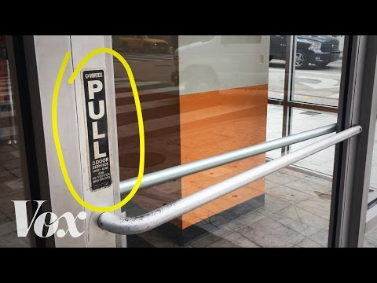
Notes:
https://99percentinvisible.org/article/norman-doors-dont-know-whether-push-pull-blame-design/

Slide 4
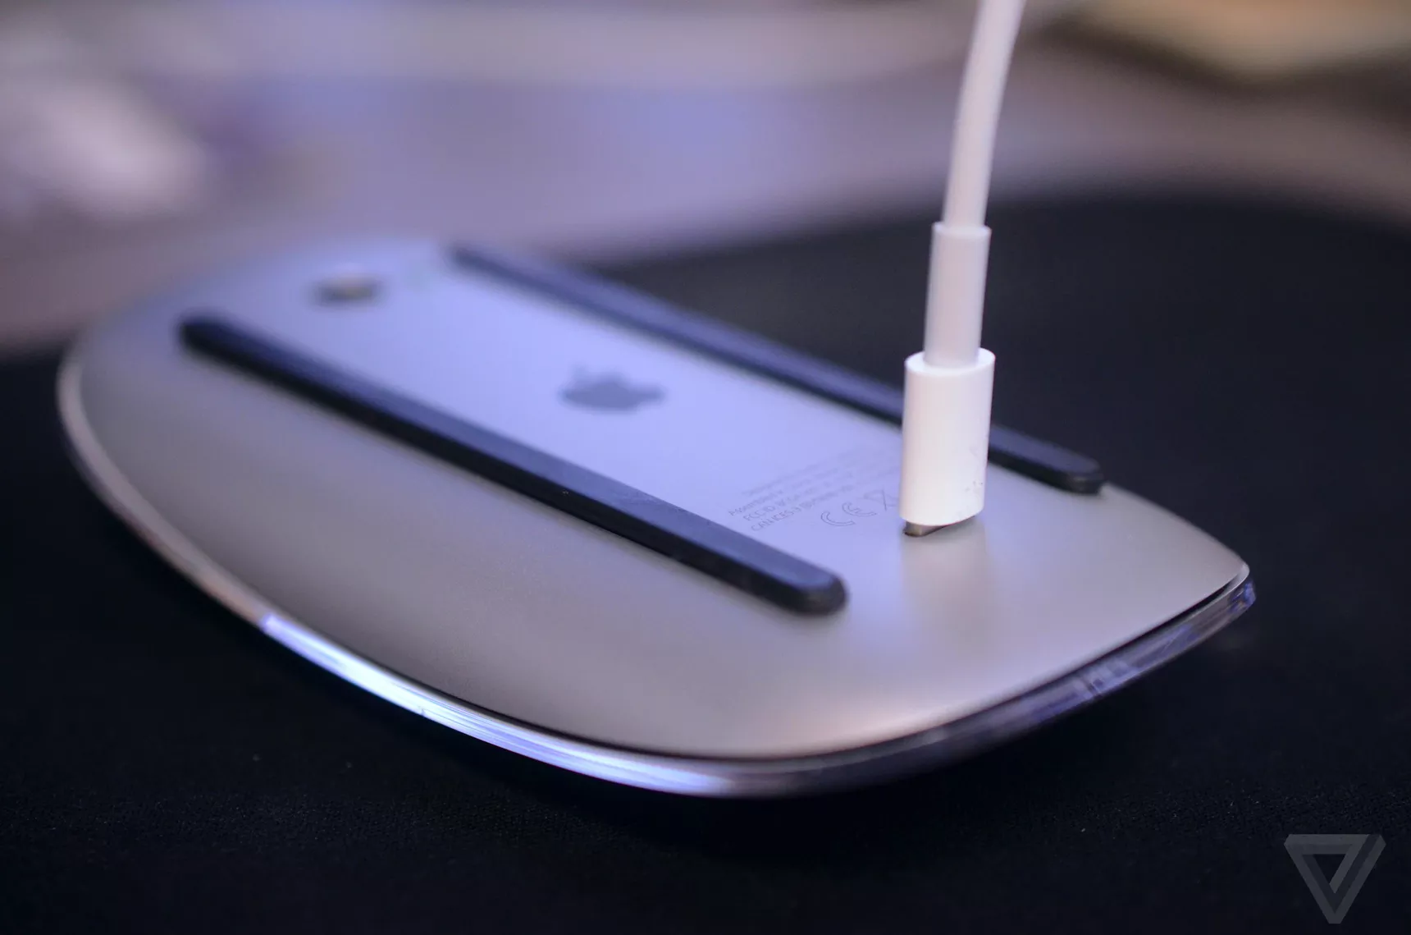

Slide 5
Basic elements of design
Lines

Slide 6
Lines
Our eyes like to follow lines
Use lines to direct the reader through your page
Breaking away from the lines can make it harder for you reader to comprehend your visual

Slide 7
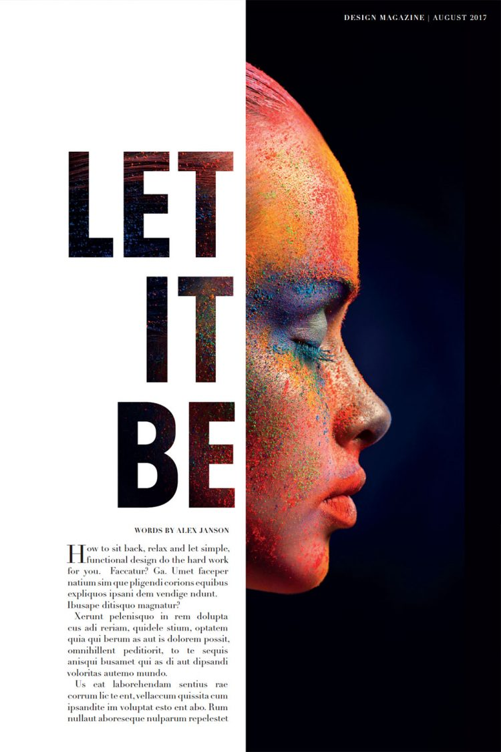
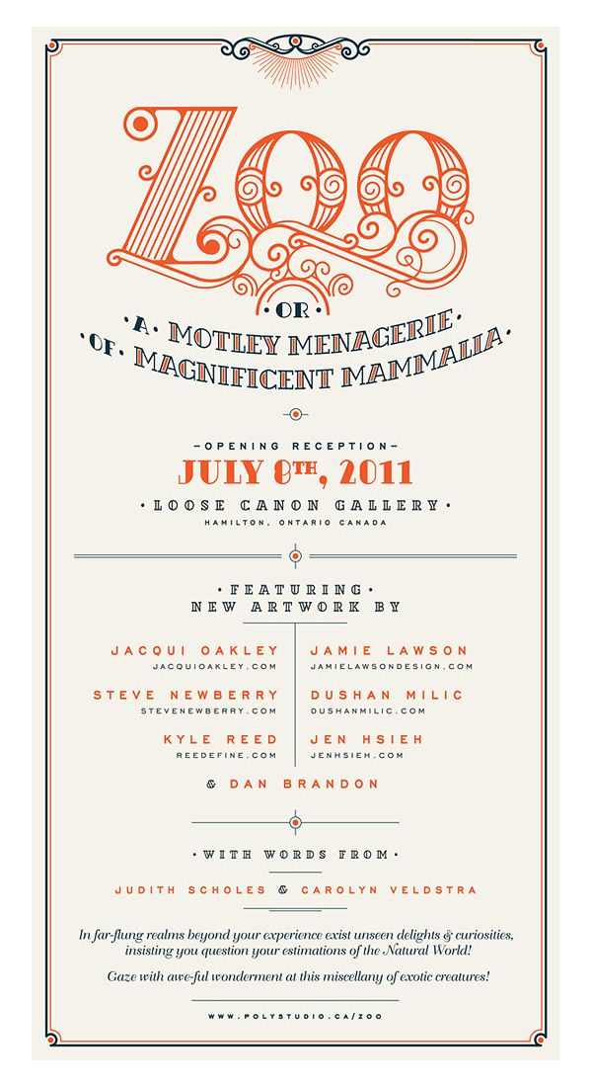
Notes:
How our eyes follow lines

Slide 8
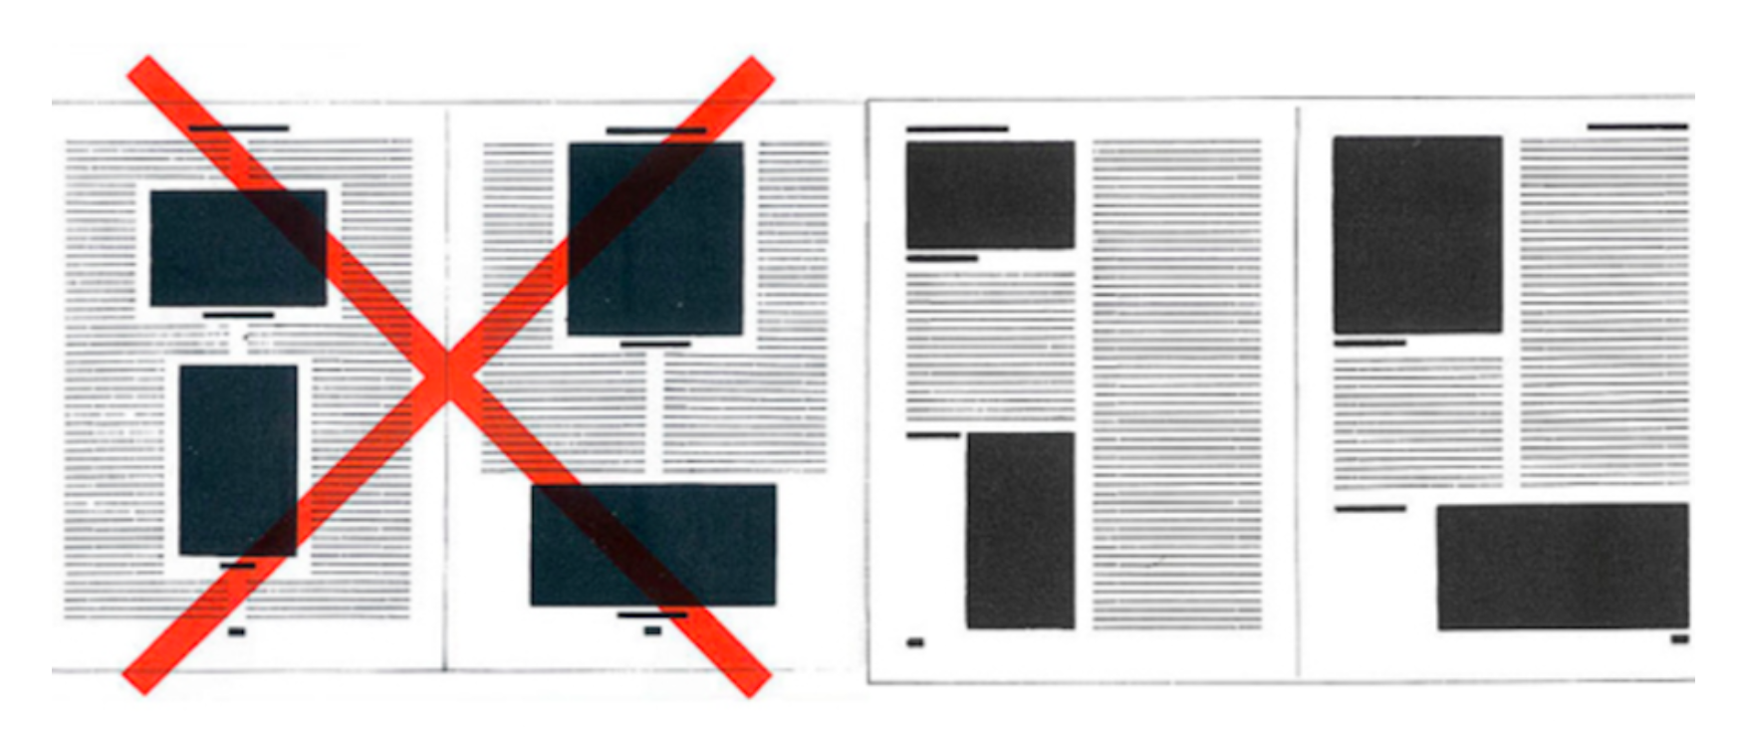

Slide 9
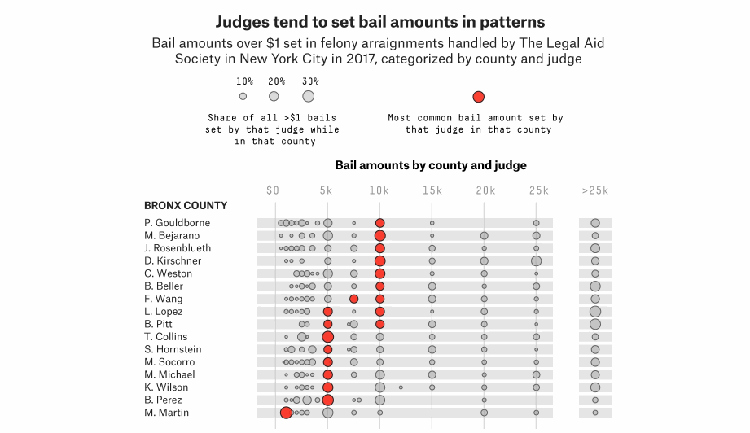
Notes:
https://fivethirtyeight.com/features/youve-been-arrested-will-you-get-bail-can-you-pay-it-it-may-all-depend-on-your-judge/

Slide 10
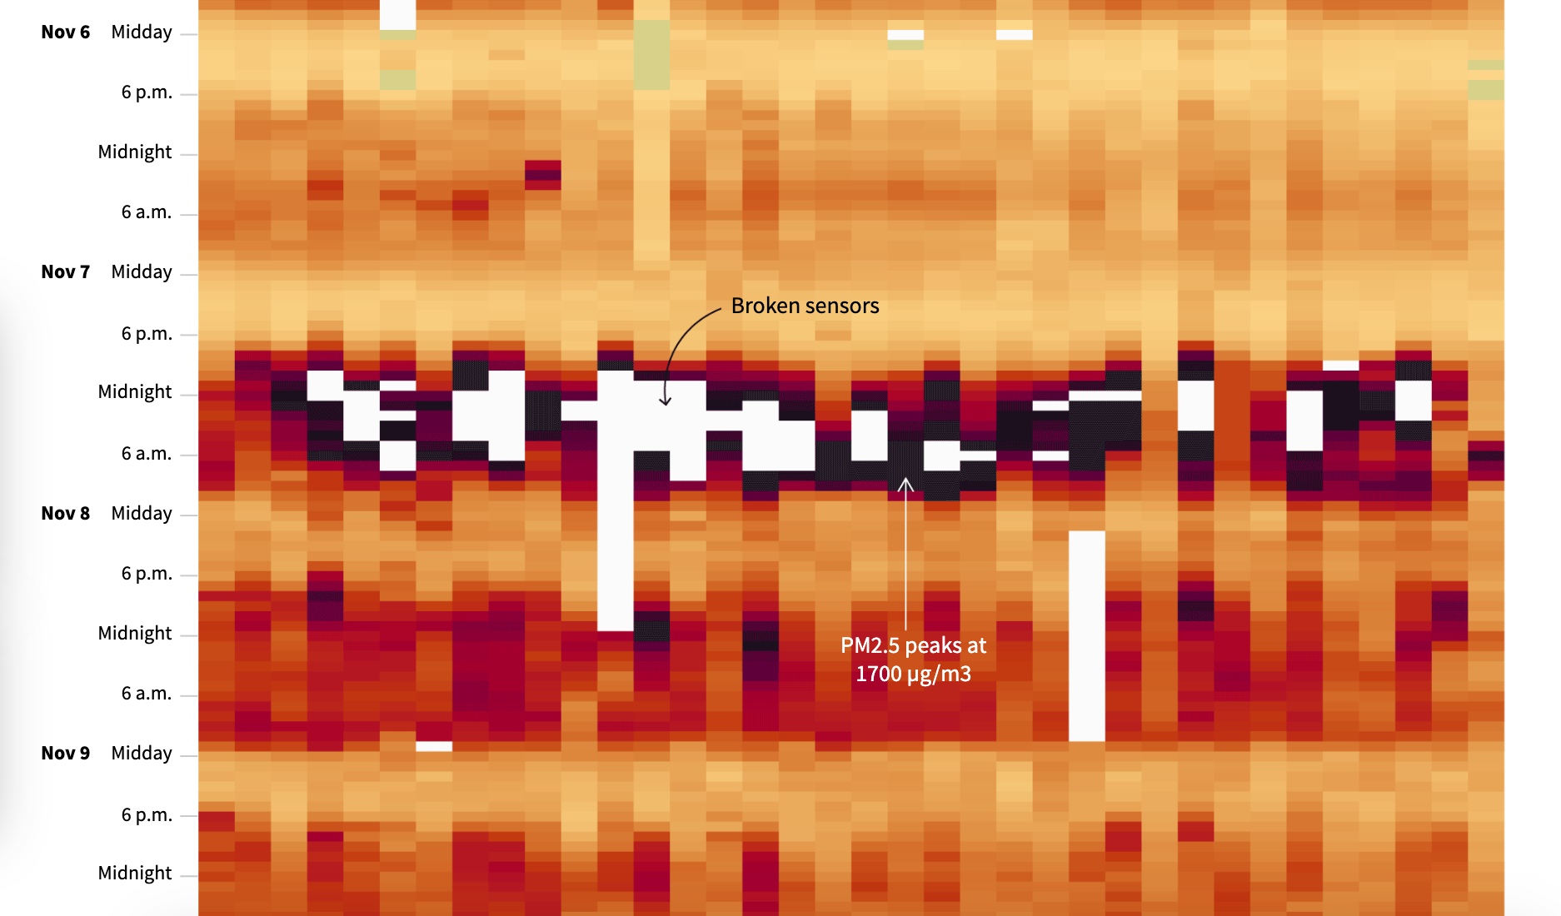
Notes:
http://graphics.reuters.com/INDIA-POLLUTION/010081VR3BW/index.html

Slide 11
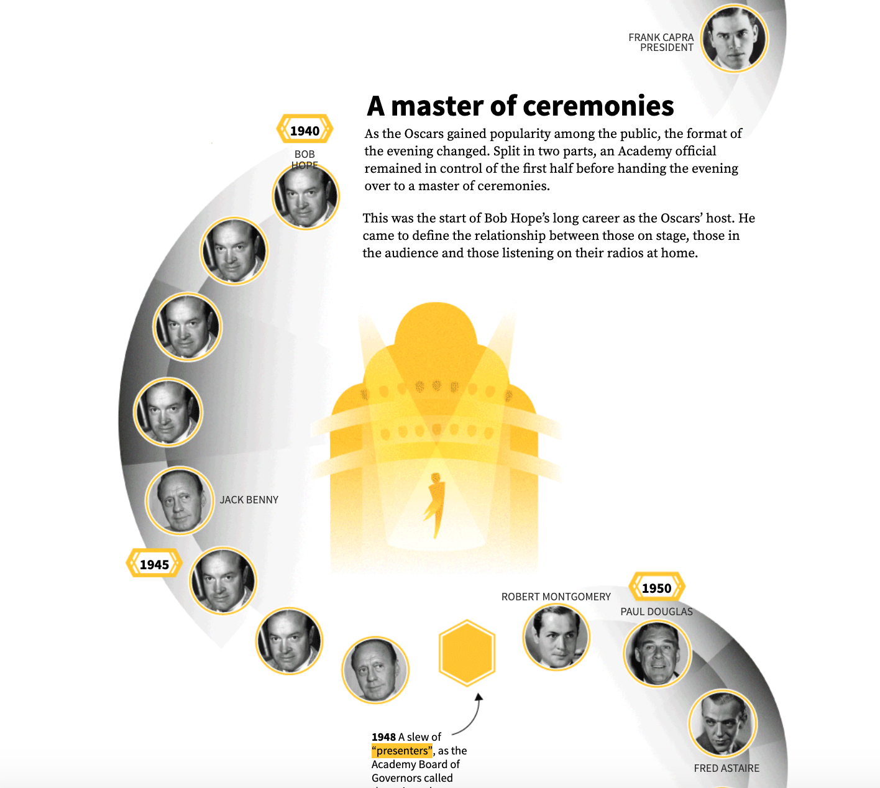
Notes:
Breaking the rules: lines that are not straight
https://graphics.reuters.com/AWARDS-OSCARS-HOST/010090SE0Y0/index.html

Slide 12
Basic elements of design
Lines
Color

Slide 13
Let’s talk about colors
Choosing a color scheme that looks *nice* is not as important as choosing colors that have meaning
Colors always denote meaning and therefore color choice has rules attached
Notes:
Color choice has a lot of meaning and just selecting a color scheme you like isn’t going to cut it. The color choices we make have to be purposeful and there are color rules to follow

Slide 14
Let’s talk about colors
Choosing a color scheme that looks *nice* is not as important as choosing colors that have meaning
Colors always denote meaning and therefore color choice has rules attached
Notes:
Color choice has a lot of meaning and just selecting a color scheme you like isn’t going to cut it. The color choices we make have to be purposeful and there are color rules to follow

Slide 15
How do we use color?
We can use color to distinguish groups of data from each other
We can use color to represent data values
We can use color to highlight
Notes:
Color choice has a lot of meaning and just selecting a color scheme you like isn’t going to cut it. The color choices we make have to be purposeful and there are color rules to follow

Slide 16


Color: Shade vs. hue
HUES
SHADES
categories
single variable range
Notes:
Color choice has a lot of meaning and just selecting a color scheme you like isn’t going to cut it. The color choices we make have to be purposeful and there are color rules to follow

Slide 17
Color: Qualitative scales
Different hues (but often of similar shade level)
Used to identify categories of information, rather than a specific value
Color should not denote any sort of order
No color is necessarily more important than another – they each equate different values
Use your color choice consistently across the whole page

Slide 18
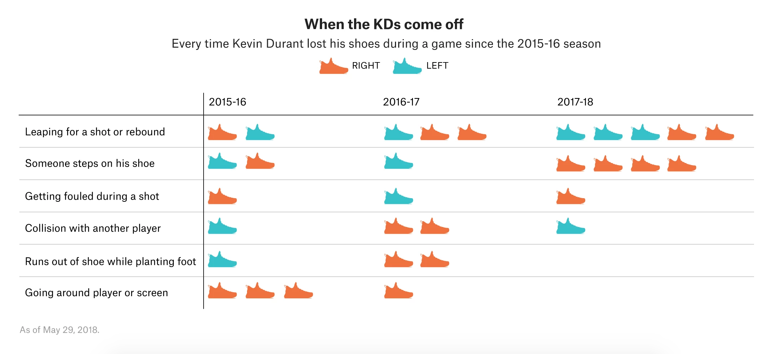
Notes:
https://fivethirtyeight.com/features/why-kevin-durants-shoes-keep-falling-off/

Slide 19
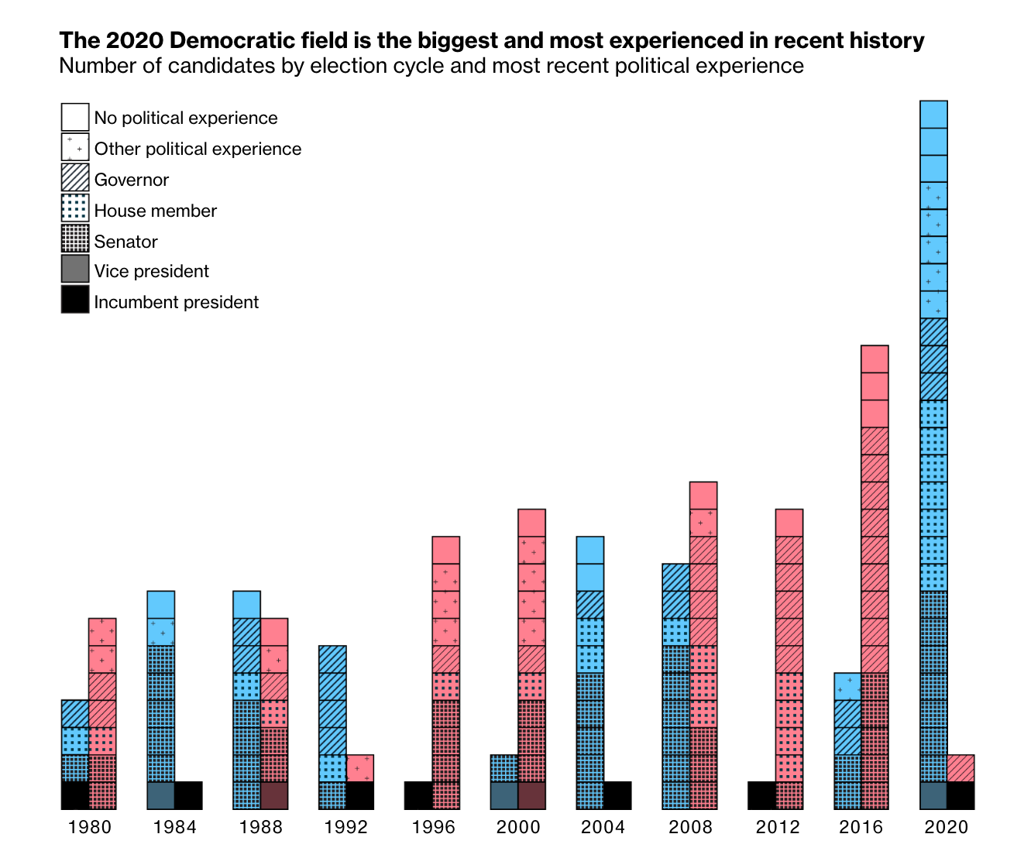
Notes:
https://www.bloomberg.com/graphics/democratic-party-candidates-running-2020-election/

Slide 20
Color: Sequential scales
Different shades of a single or similar hue
Used to denote differences in value of a single variable, using a linear (and often numerical) scale
A sequence of colors that indicates how values relate to each other
i.e. which ones are smaller or larger than other ones, and how distant two specific values are from each other
The deeper the shade, often the stronger or more intense the value.
Depends on the data set, is not always the largest number

Slide 21
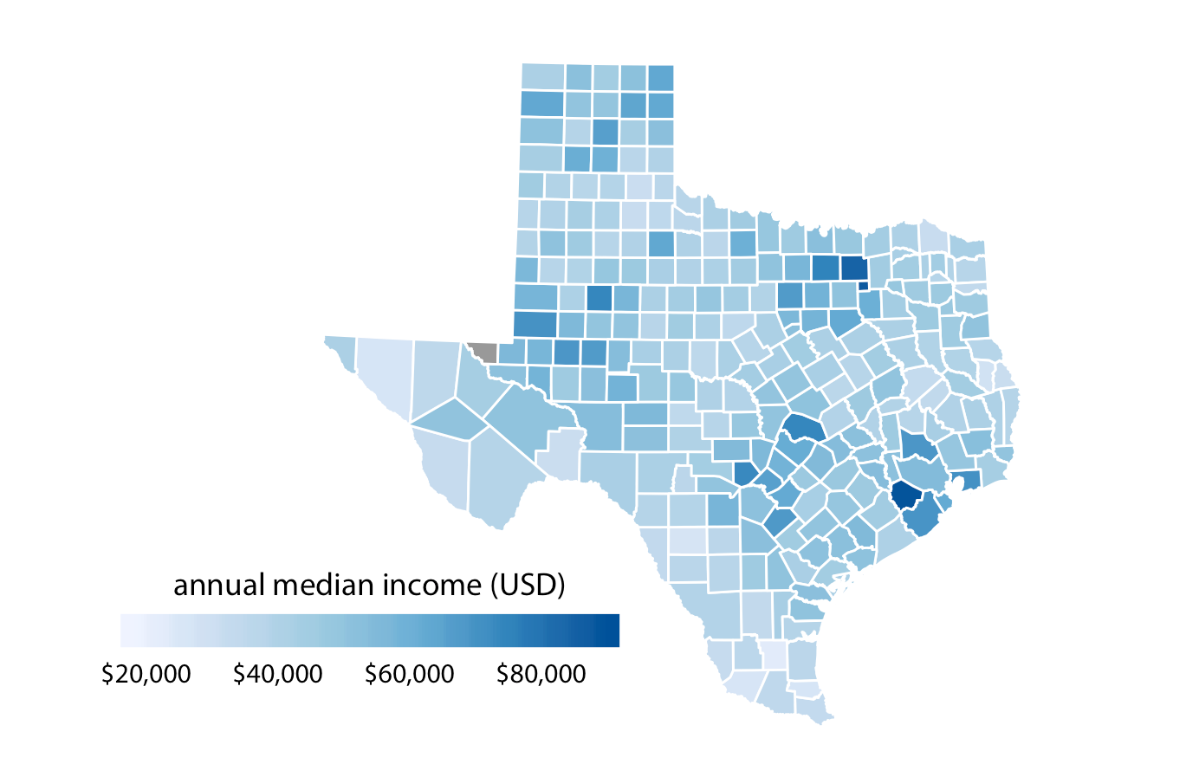

Slide 22
Color: Divergent scales
Can be thought of as two sequential scales joining at a midpoint color.
Are really useful for showing the up/down of chart
Ex: positive vs negative values, above and below a certain threshold, before or after a certain point in time, majority vs minority

Slide 23
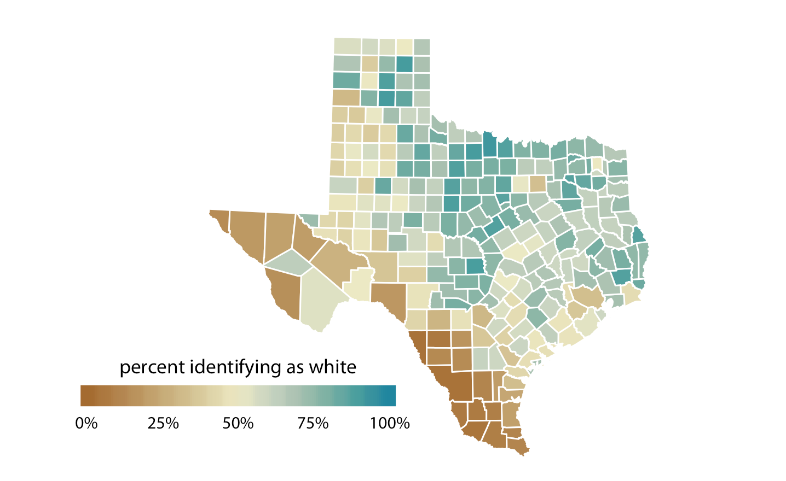

Slide 24
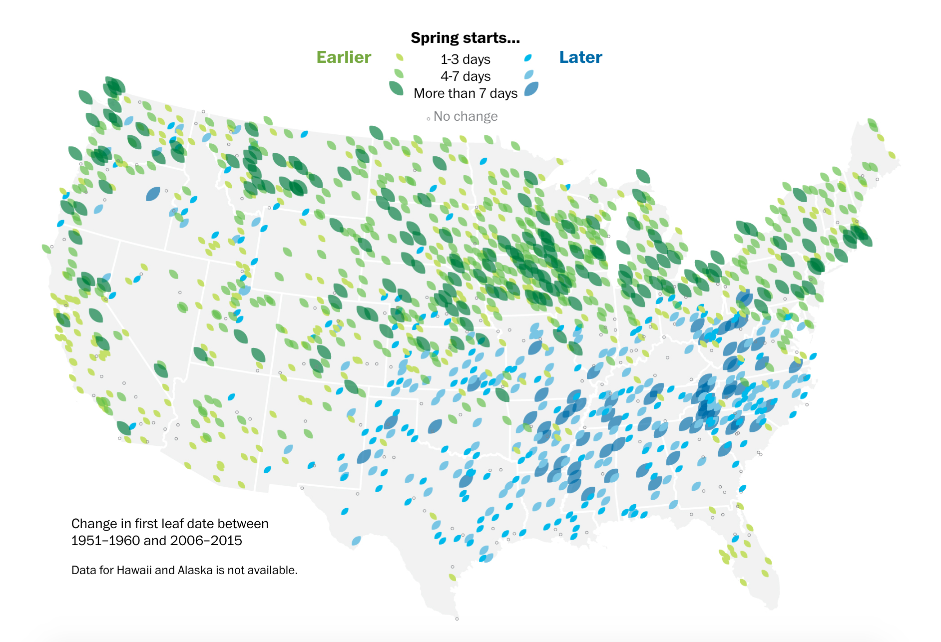
Notes:
https://www.washingtonpost.com/graphics/2018/national/early-spring/?utm_term=.1a9683b48ecf

Slide 25
Color: Highlighting with color
We can use specific colors that contrast from the other colors to highlight specific data we are interested in.
Color is a great way to draw your readers’ attention to a specific point you’re trying to make
Your baseline color should not compete with your highlight color: Use different shades to distinguish them
Example: A light gray as your baseline and a bright red as your highlight

Slide 26
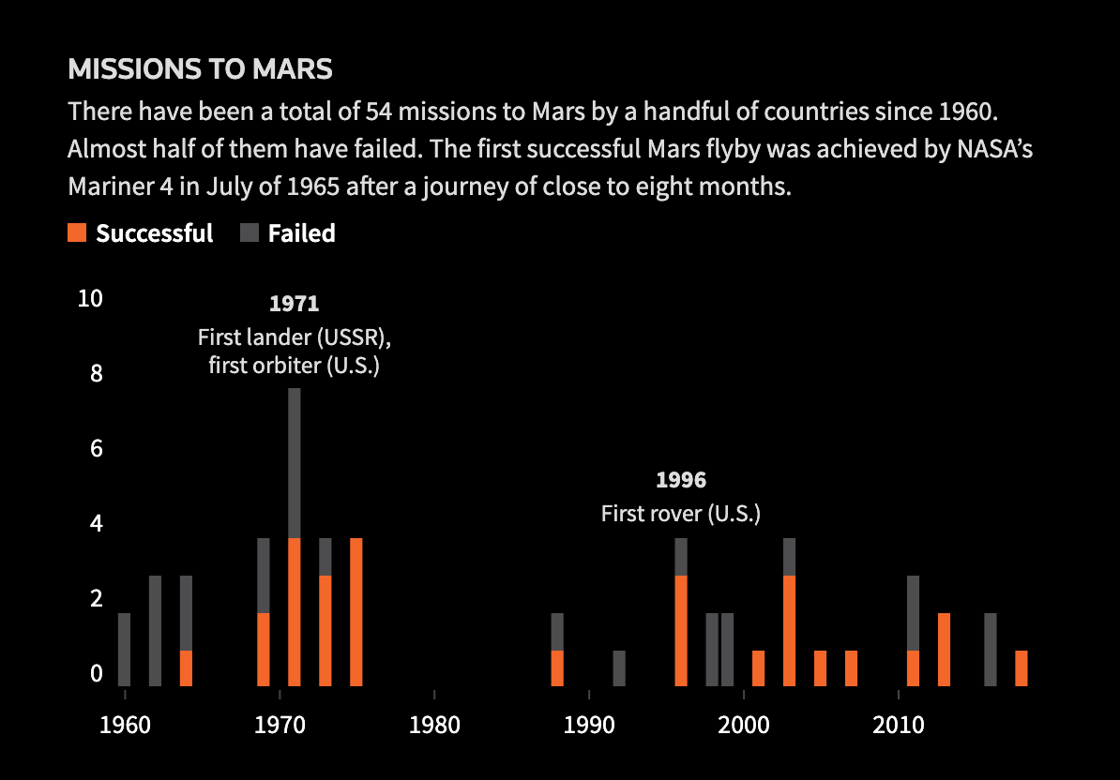
Notes:
http://graphics.reuters.com/SPACE-EXPLORATION-MOON/0100B0750FC/index.html

Slide 27
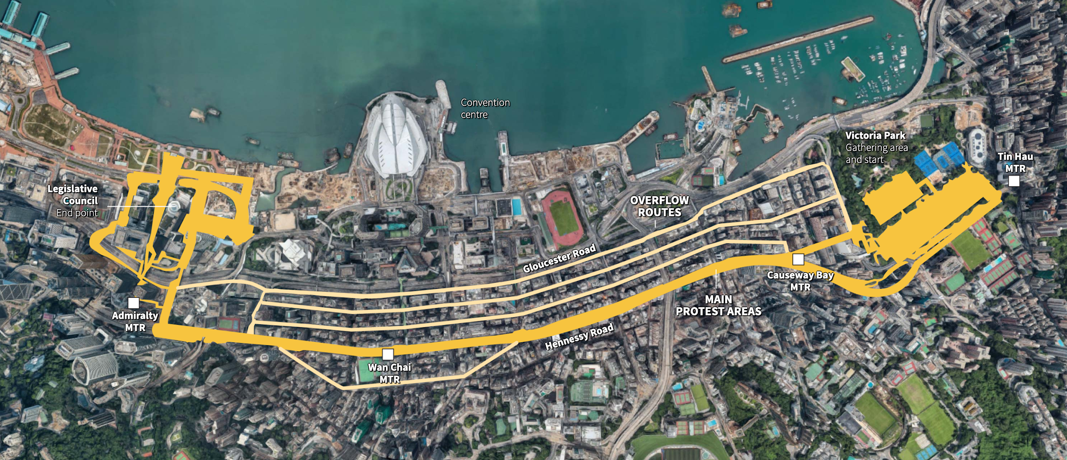
Notes:
http://graphics.reuters.com/HONGKONG-EXTRADITION-PROTESTS/0100B01001H/index.html

Slide 28
Color rules
Content-driven colors: what is the color trying to tell us? Example:
Red = Negative, stop, alert
Green = Positive, go, “OK” or correct
Only use red and blue together for U.S. politics related things
If you’re using more than one color, its a good idea to keep them in the same shade range – if one is really dark and one is really light, the user could misinterpret it as meaning something it doesn’t

Slide 29
Tools for color choice
Color brewer: http://colorbrewer2.org/
Material colors: https://material.io/tools/color/

Slide 30
Basic elements of design
Lines
Color
Typography

Slide 31
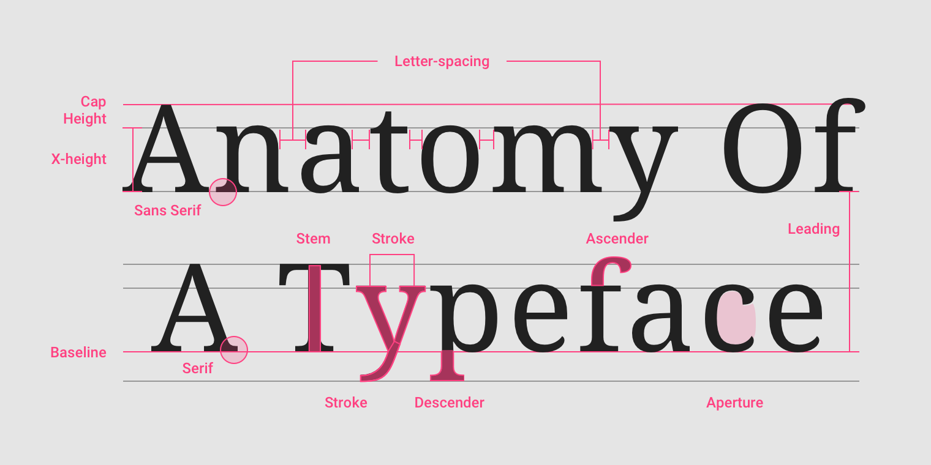

Slide 32
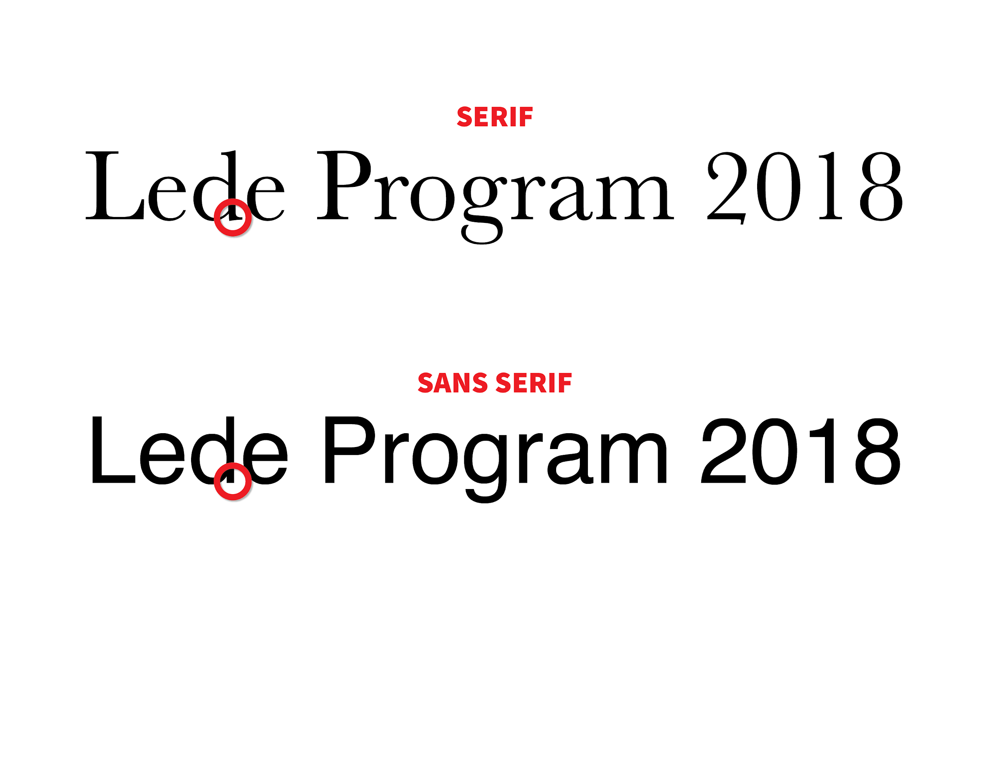

Slide 33
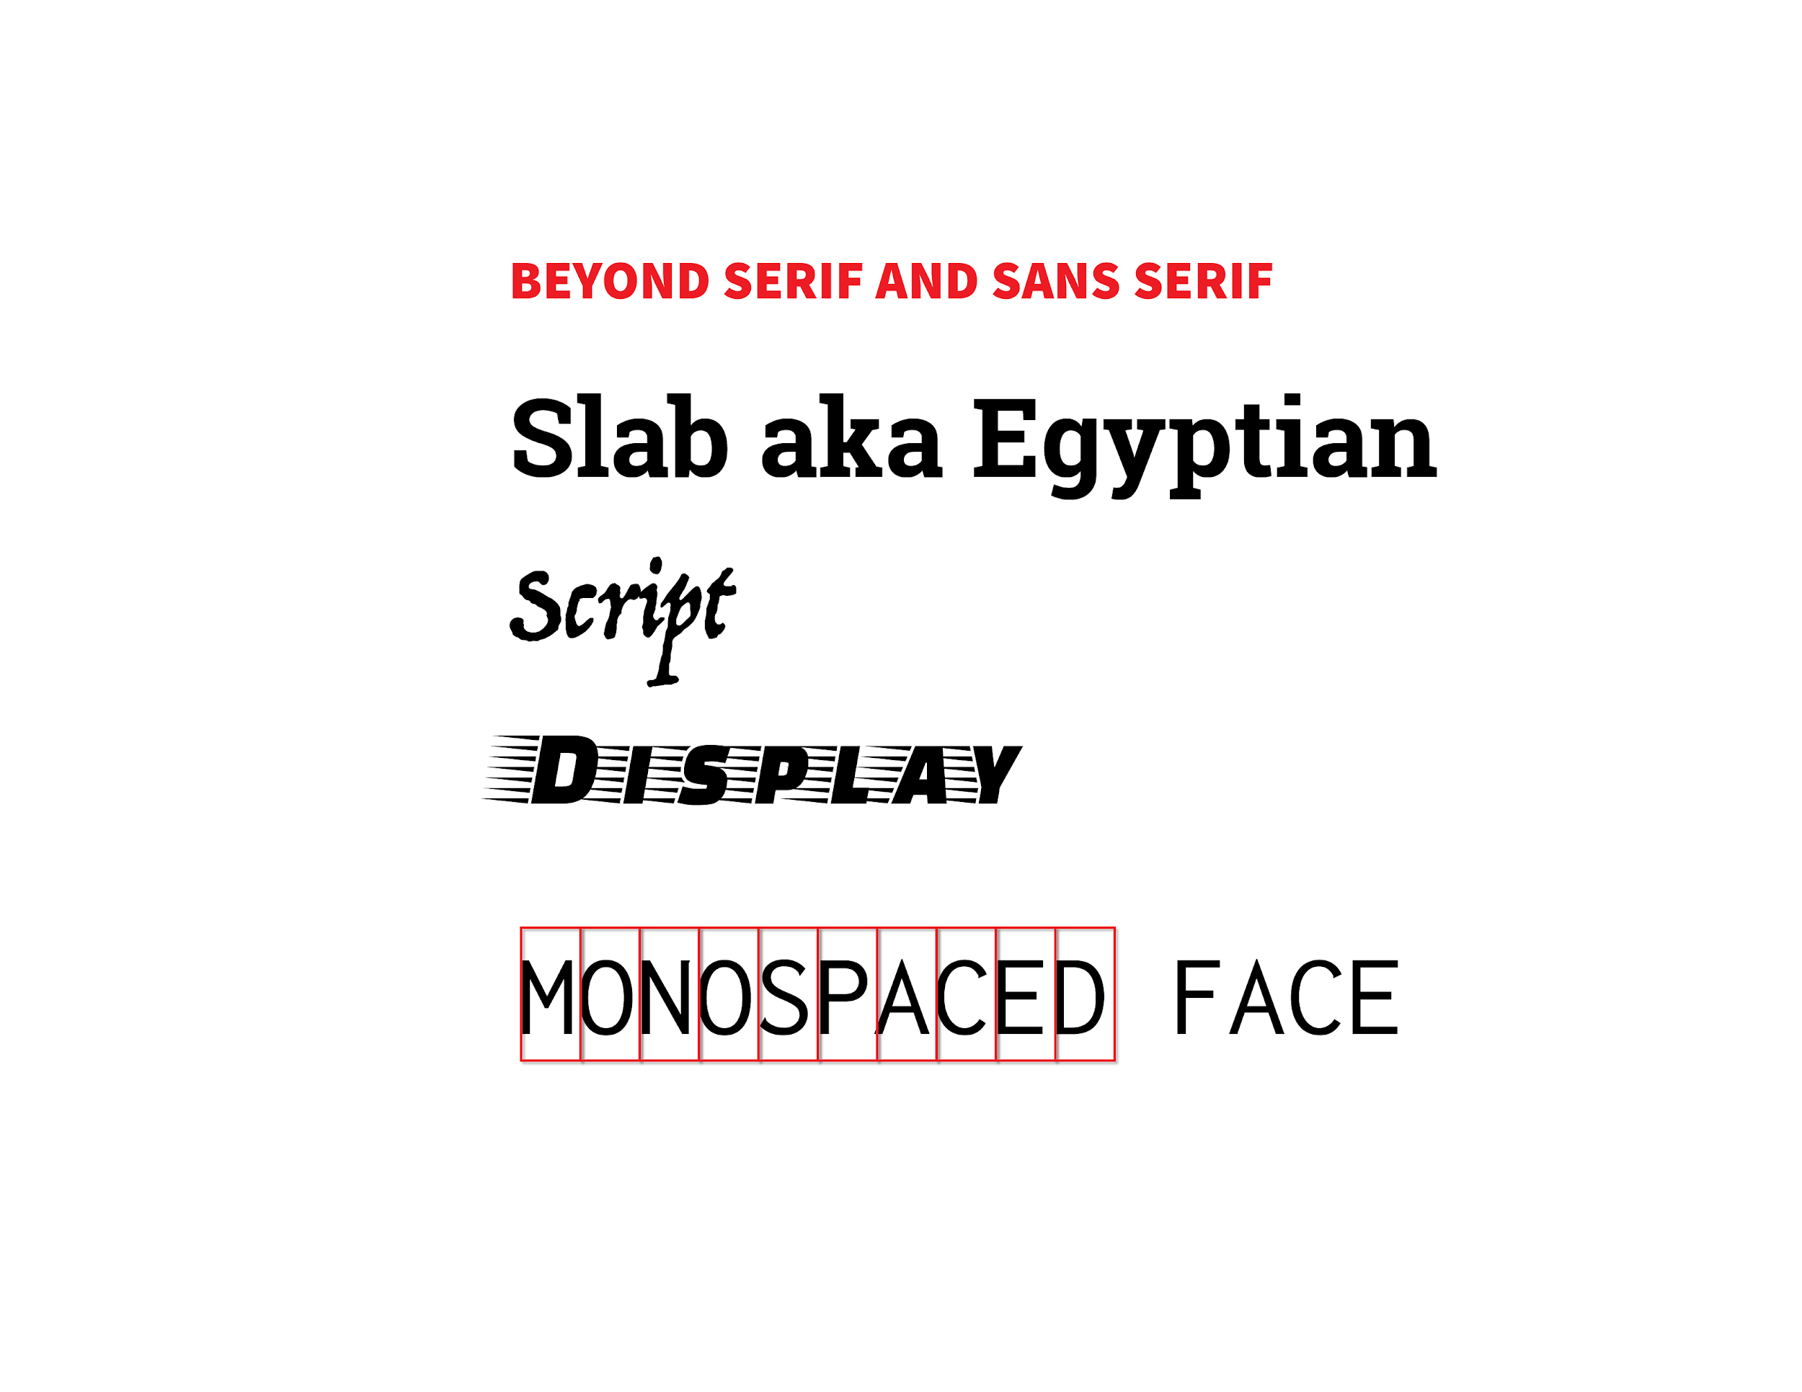

Slide 34
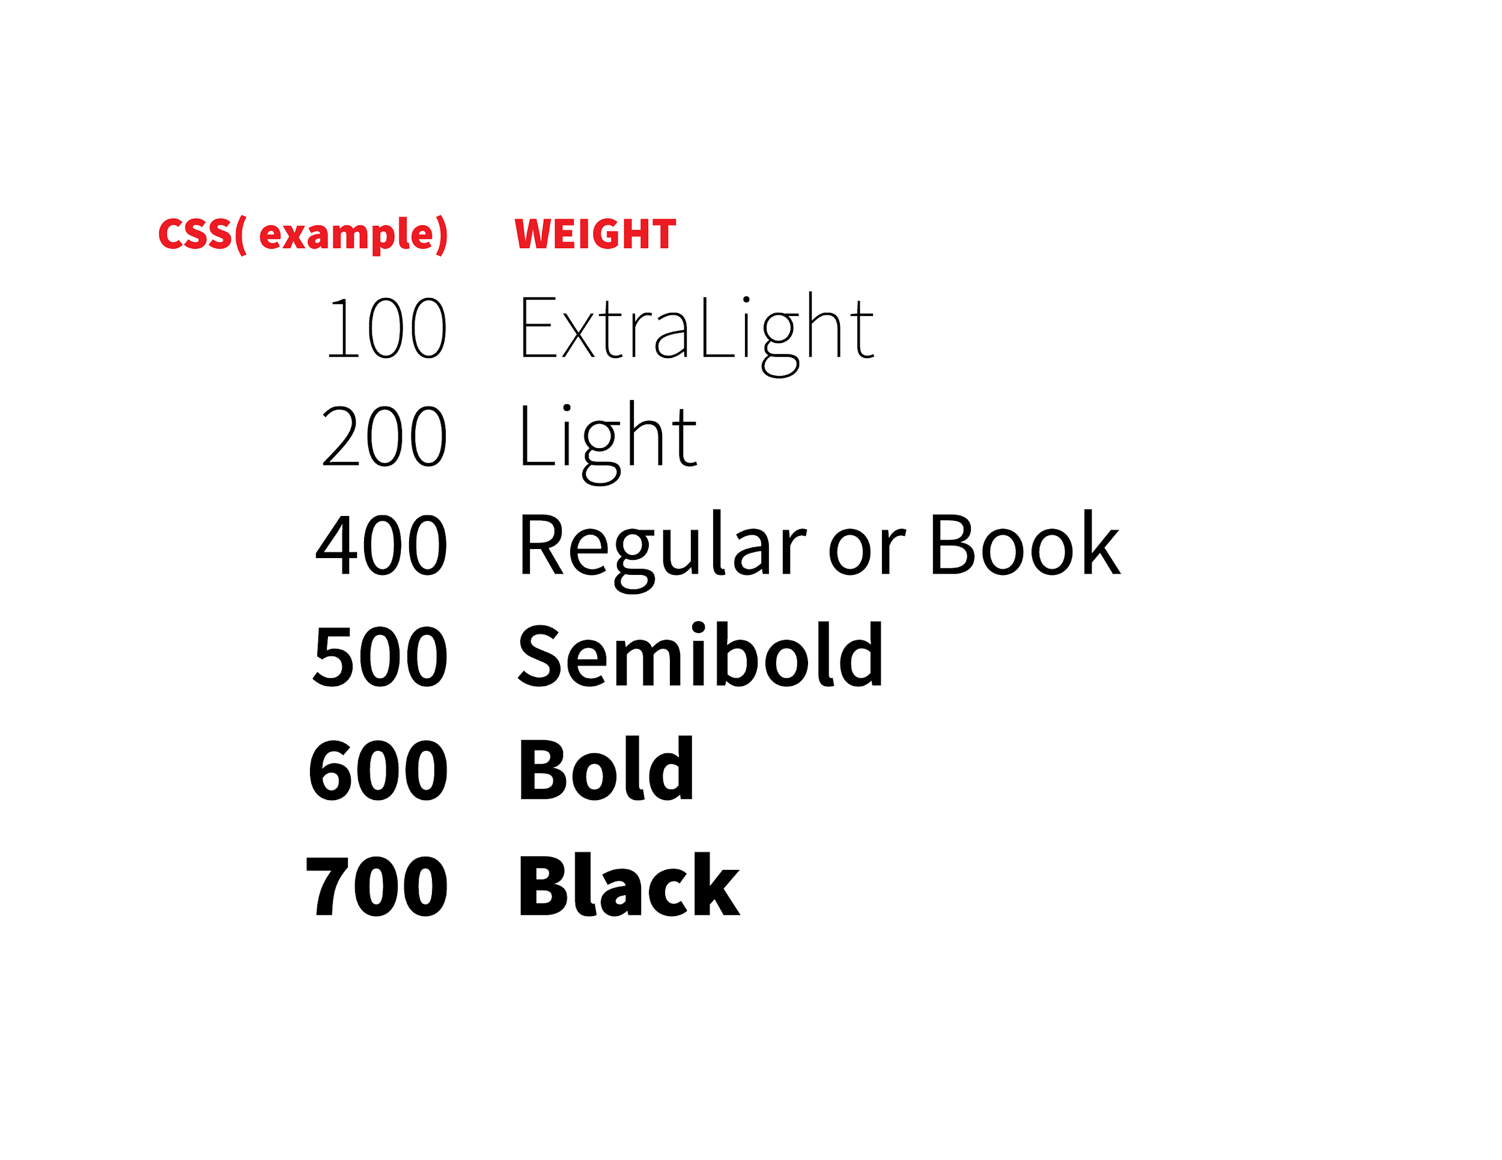

Slide 35
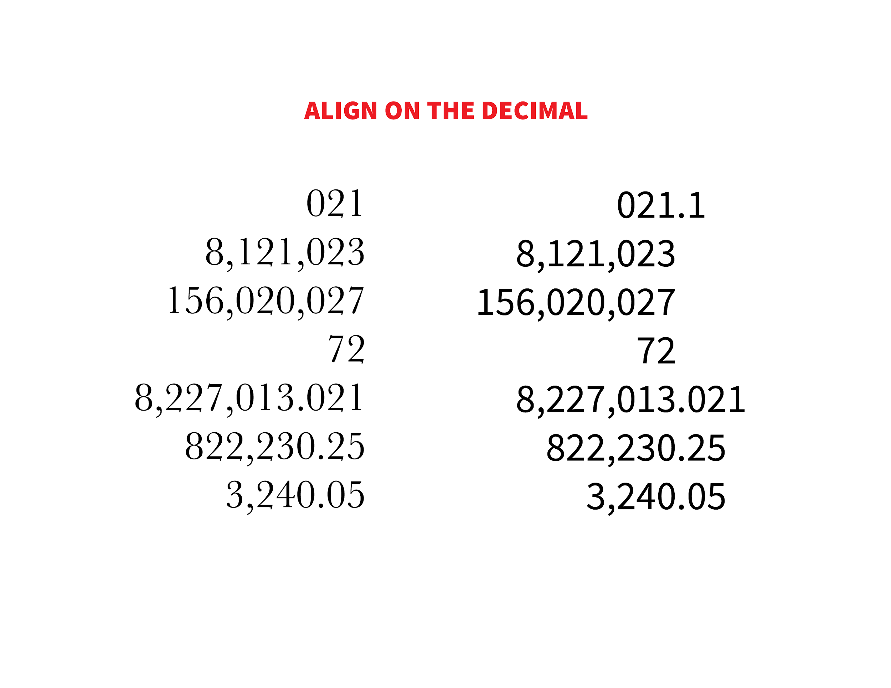

Slide 36
Designing with typography
Keep to two font families, with rare exceptions there can be three
For visual variety, use different weights and styles, like adjusting letter spacing, font weight and capitalization
You can use typography to establish hierarchy of information on your page

Slide 37
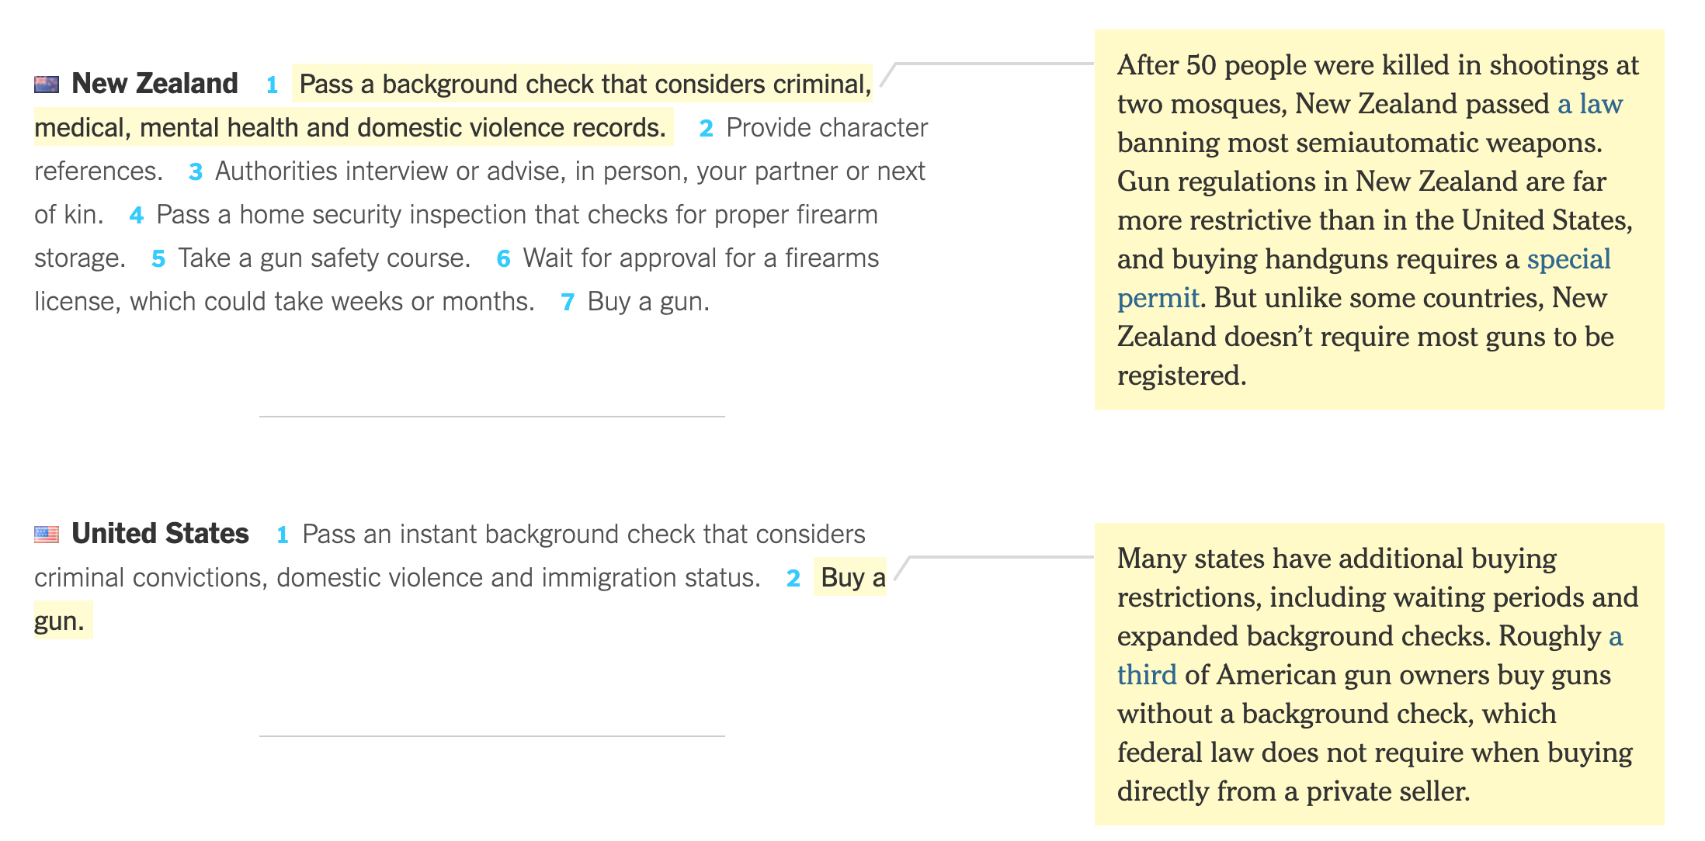
Notes:
https://www.nytimes.com/interactive/2018/03/02/world/international-gun-laws.html

Slide 38
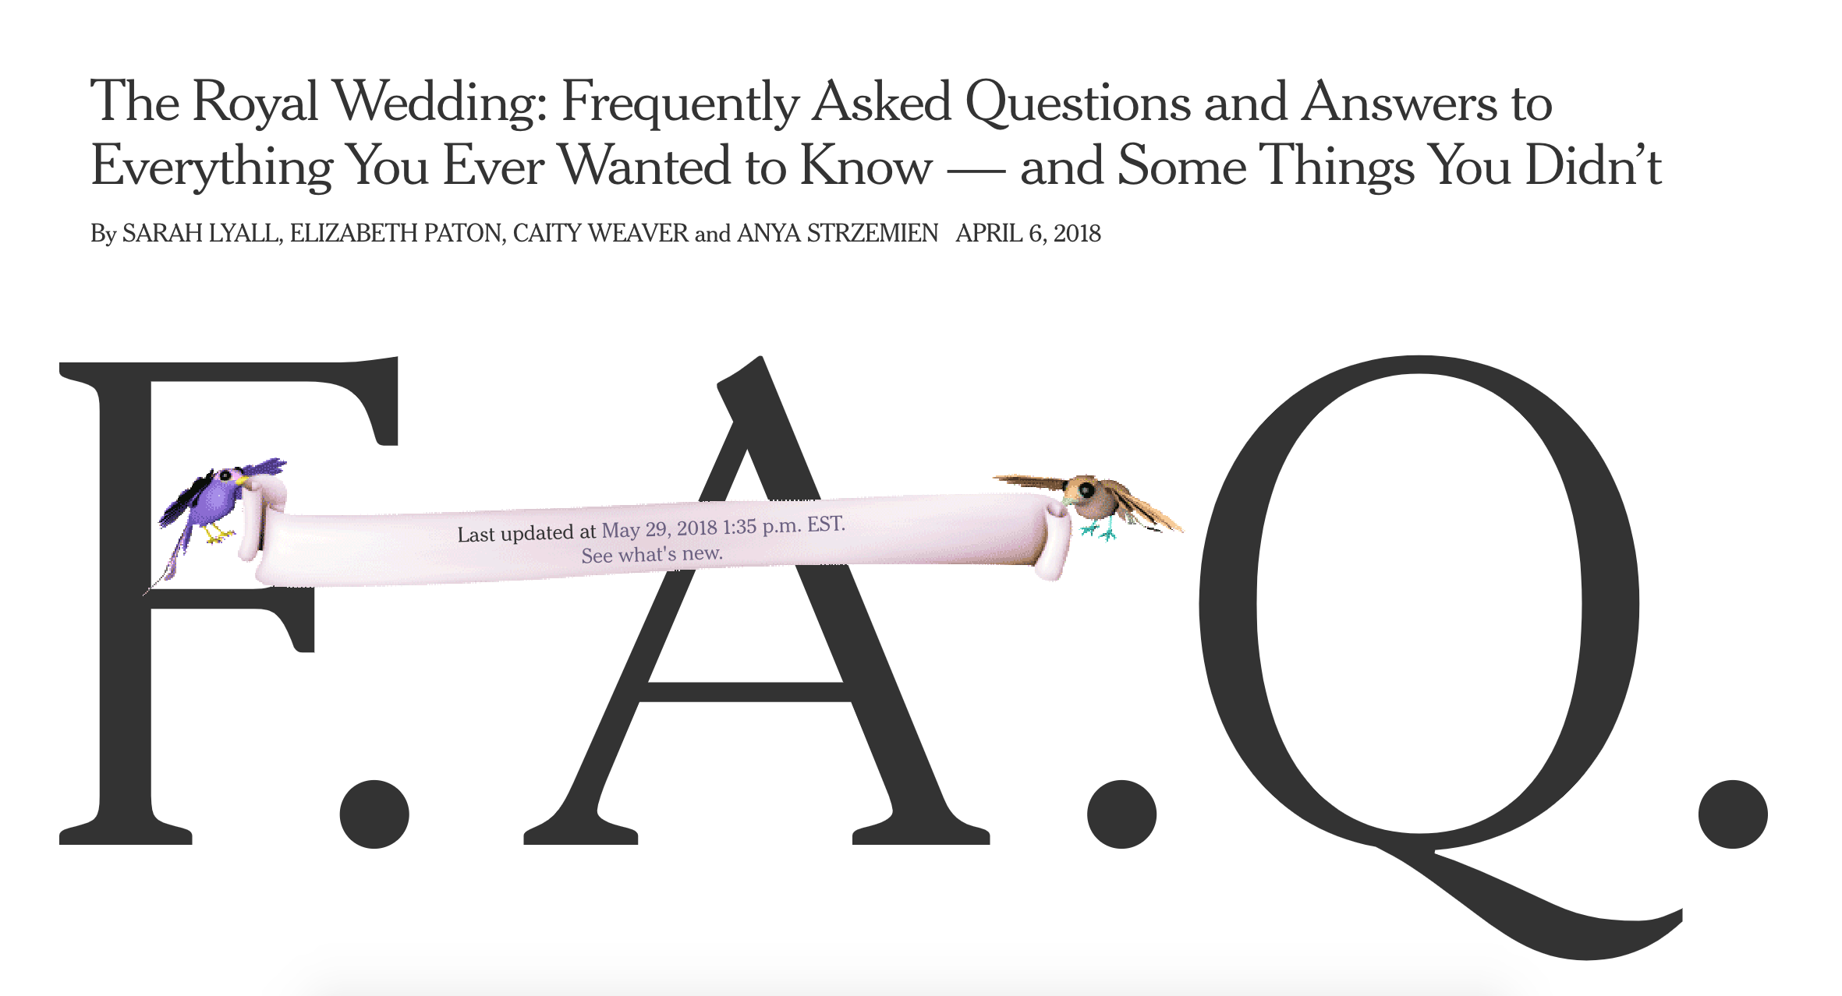
Notes:
https://www.nytimes.com/interactive/2018/04/06/style/meghan-markle-prince-harry-royal-wedding.html

Slide 39
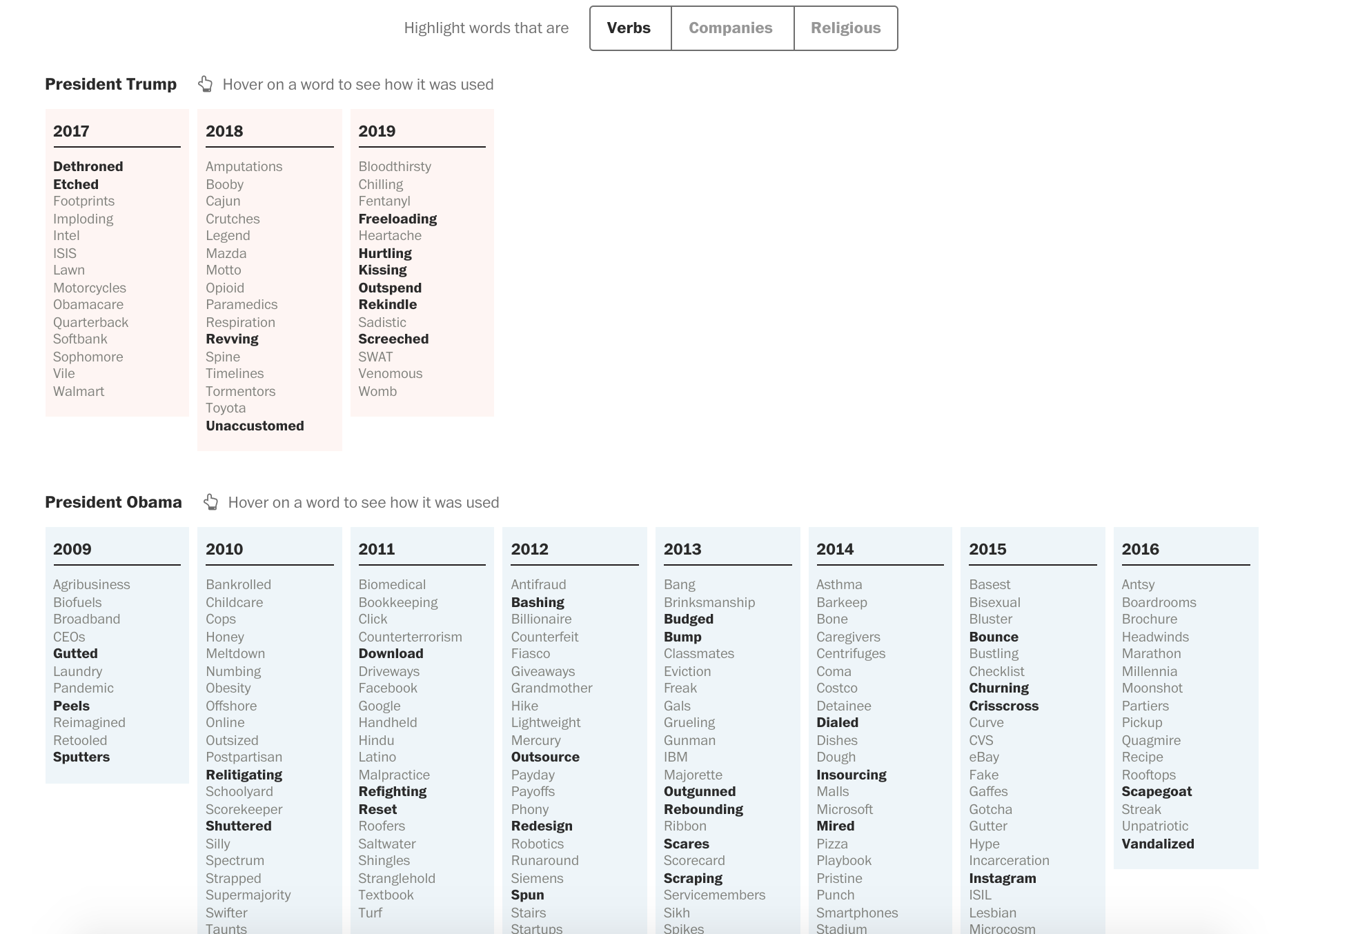
Notes:
https://www.washingtonpost.com/graphics/2018/politics/trump-state-of-the-union/?utm_term=.50bae38fefe5

Slide 40
Basic elements of design
Lines
Color
Typography
Space

Slide 41
Space
Give your design room to “breathe”
Don’t be afraid of white space
Use groups of content and white space to direct your eye and form natural information groups/separations

Slide 42
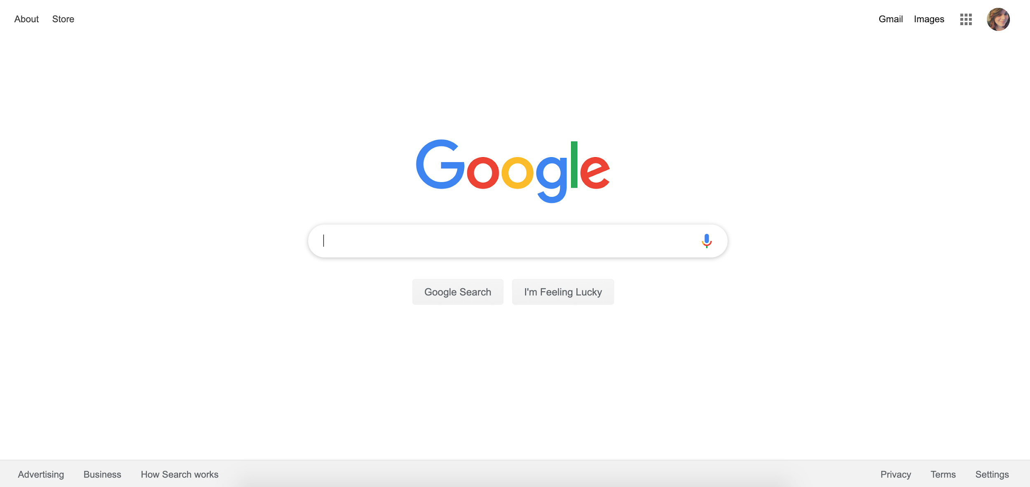

Slide 43

Notes:
How we use space helps create grouping of items in our brains

Slide 44
Basic elements of design
Lines
Color
Typography
Space
Size/scale

Slide 45
Size and scale
Use size hierarchy to establish importance of different types of content
You can also use size to establish differences – if two things are different, make them very different!
Size exaggeration can help with this … you don’t want the difference to be so small that it seems like a mistake
Size and scale also help us create relationships between the items on our pages

Slide 46
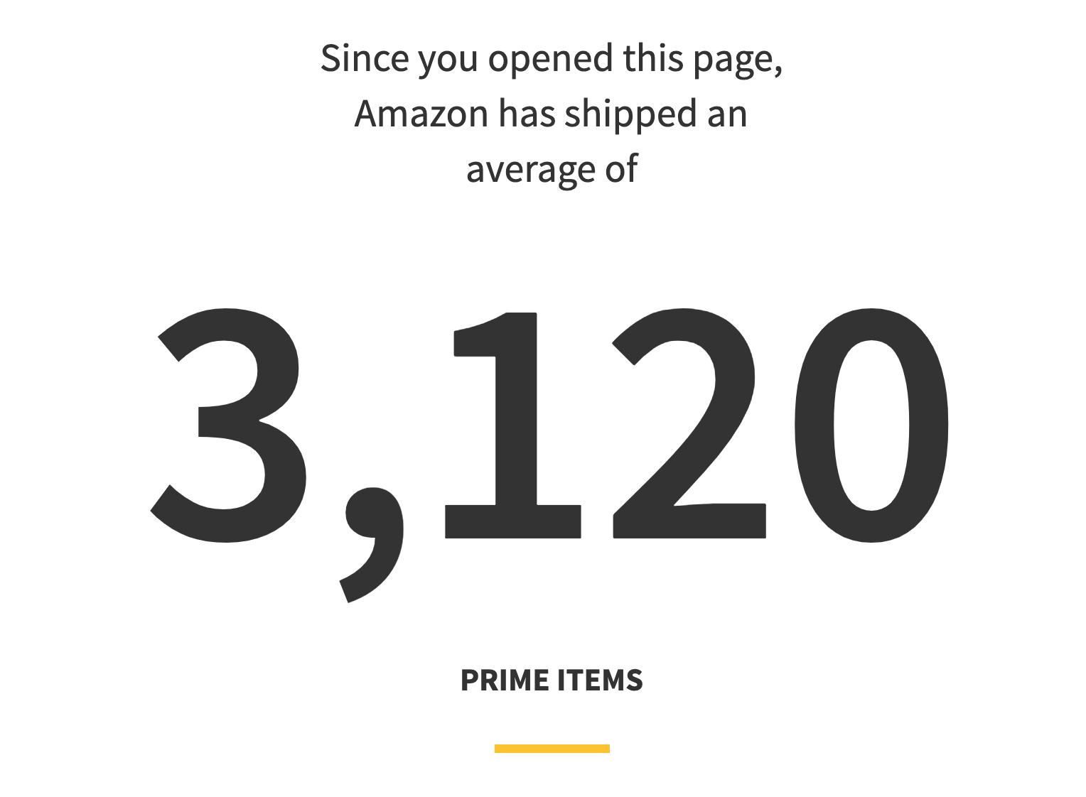
Notes:
http://graphics.reuters.com/AMAZON.COM-PRIME/010060SY1HT/index.html

Slide 47
Break time

Slide 48
Principles of design
How do we use these elements in practice?

Slide 49
Principles of design
Contrast: If it’s not the same, make it really different!

Slide 50
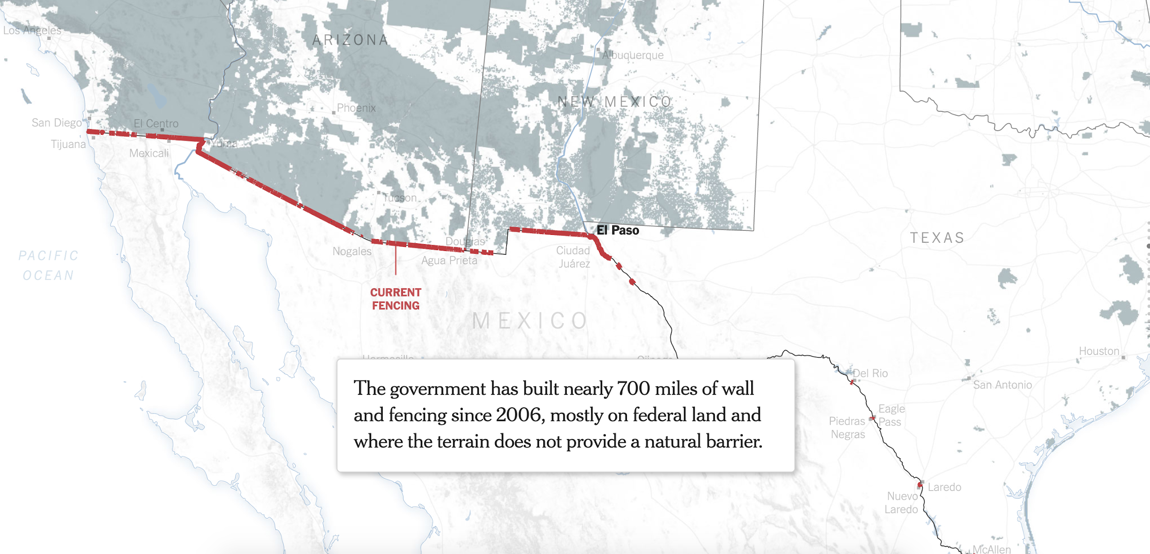
Notes:
https://www.nytimes.com/interactive/2018/02/05/us/border-wall.html

Slide 51
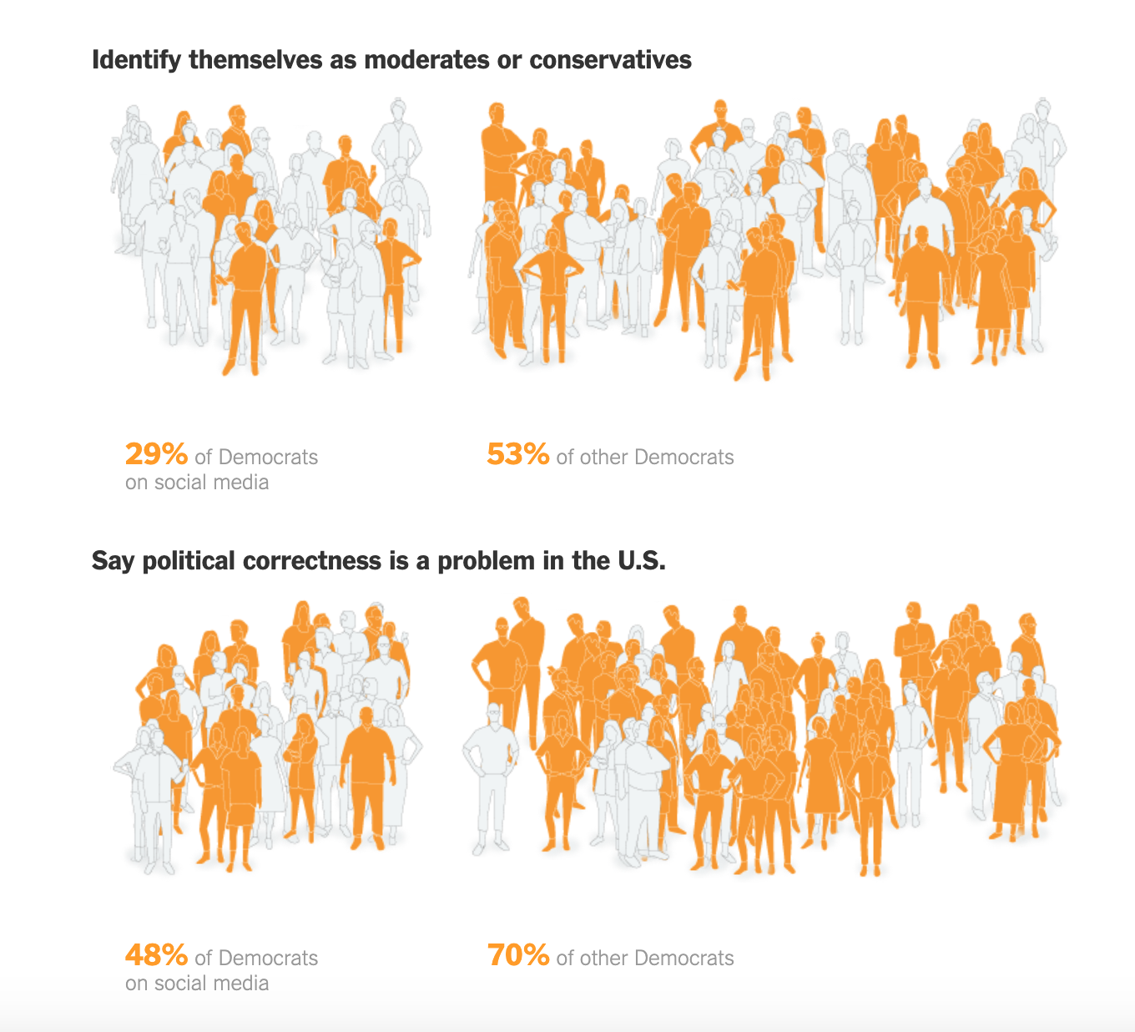
Notes:
https://www.nytimes.com/interactive/2019/04/08/upshot/democratic-electorate-twitter-real-life.html

Slide 52
Principles of design
Contrast: If it’s not the same, make it really different!
Alignment: Follow lines and use white space to direct the reader’s eye

Slide 53
This text here in this paragraph is left aligned
This text here in this paragraph is center aligned
This text here in this paragraph is right aligned

Slide 54
This text here in this paragraph is left aligned
This text here in this paragraph is center aligned
This text here in this paragraph is right aligned

Slide 55
Which group of text has the stronger line?
Which group of text has the stronger line?

Slide 56
Which group of text has the stronger line?
Which group of text has the stronger line?
Notes:
We read left to right (at least, we do in english)
Align to how we expect the user to read
Headlines are exception: but thats because we use alignment as CONTRAST to denote that it is different from the body text

Slide 57
Principles of design
Contrast: If it’s not the same, make it really different!
Alignment: Follow lines and use white space to direct the reader’s eye
Repetition: Train your audience by making consistent design choices

Slide 58
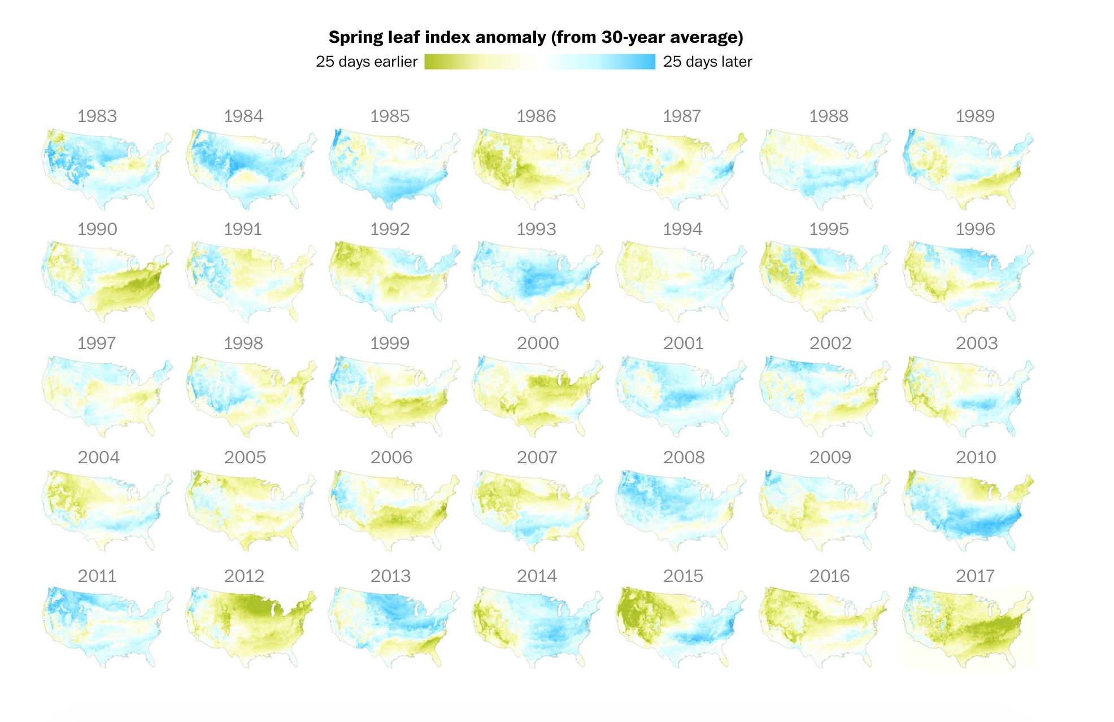
Notes:
Small multiples
Consistent color choices and type choices

Slide 59
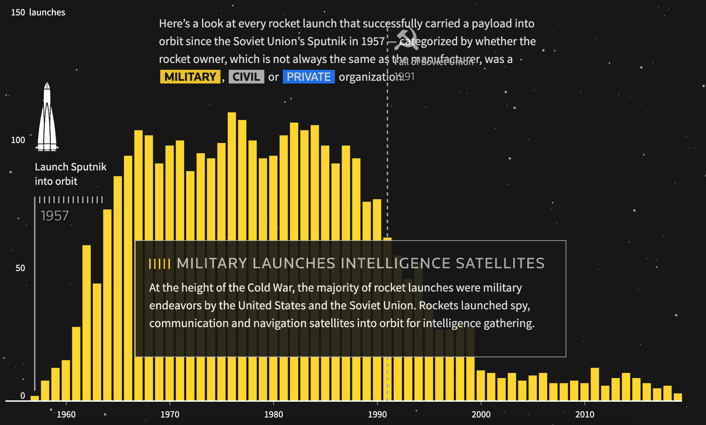
Notes:
http://graphics.reuters.com/SPACE-EXPLORATION-NEW-SPACE/0100B03R062/index.html

Slide 60
Principles of design
Contrast: If it’s not the same, make it really different!
Alignment: Follow lines and use white space to direct the reader’s eye
Repetition: Train your audience by making consistent design choices
Hierarchy: Give the items on your page importance through size, space and proximity to other things

Slide 61
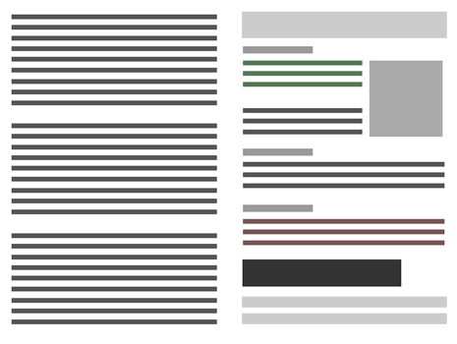
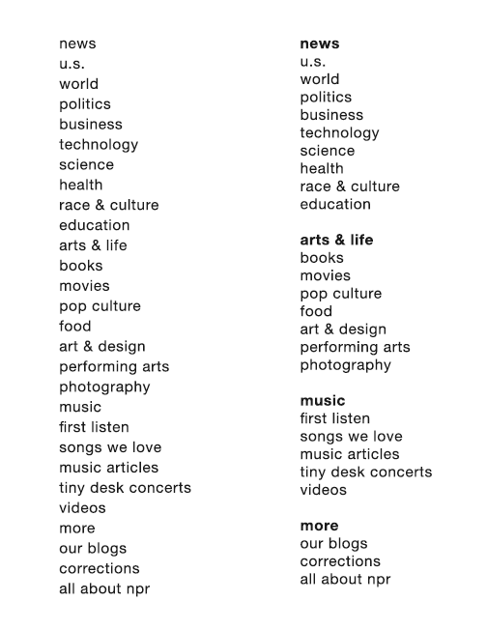
Notes:
Hierarchy of things

Slide 62
Breaking the rules
When and why might we break design rules?

Slide 63
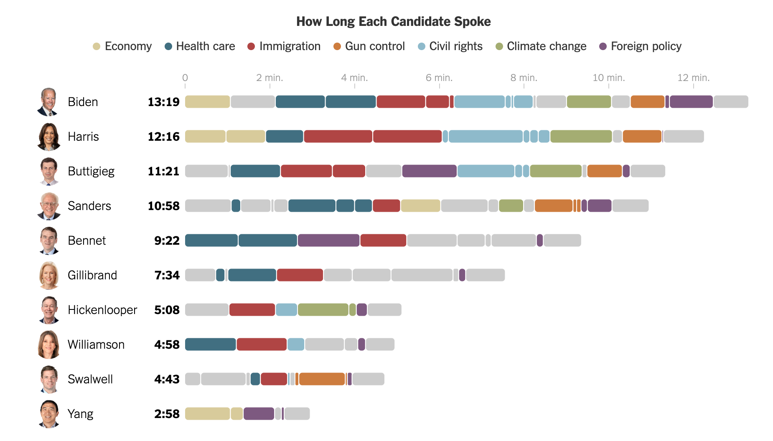
Notes:
https://www.nytimes.com/interactive/2019/06/27/us/elections/debate-speaking-time.html

Slide 64
Group critiques
Follow the principles of contrast, alignment, repetition and hierarchy as a guideline to critique each other’s projects
When we’re done, we’ll do class-wide critiques. I’ll call on you at random to present!

